Slide 1
Basic Business Statistics
11th Edition
Chapter 3
Numerical Descriptive Measures
Basic Business Statistics, 11e © 2009 Prentice-Hall, Inc.
Chap 3-<number>

Slide 2
Learning Objectives
In this chapter, you learn:
To describe the properties of central tendency, variation, and shape in numerical data
To calculate descriptive summary measures for a population
To calculate descriptive summary measures for a frequency distribution
To construct and interpret a boxplot
To calculate the covariance and the coefficient of correlation
Basic Business Statistics, 11e © 2009 Prentice-Hall, Inc..
Chap 3-<number>

Slide 3
Summary Definitions
The central tendency is the extent to which all the data values group around a typical or central value.
The variation is the amount of dispersion, or scattering, of values
The shape is the pattern of the distribution of values from the lowest value to the highest value.
Basic Business Statistics, 11e © 2009 Prentice-Hall, Inc..
Chap 3-<number>

Slide 4
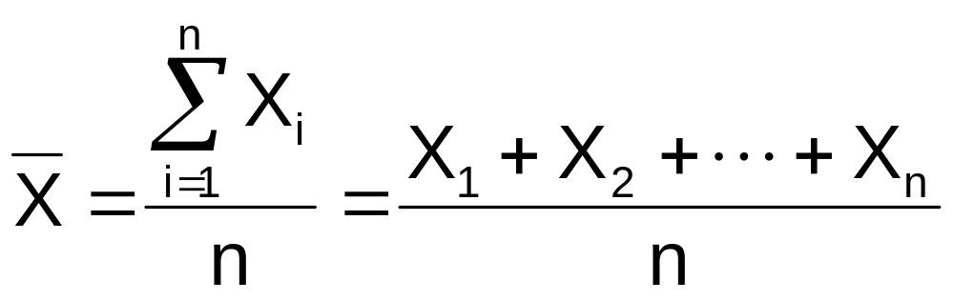
Measures of Central Tendency:
The Mean
The arithmetic mean (often just called “mean”) is the most common measure of central tendency
  For a sample of size n:
Pronounced x-bar
The i^{th} value
Sample size
Observed values
Basic Business Statistics, 11e © 2009 Prentice-Hall, Inc..
Chap 3-<number>

Slide 5
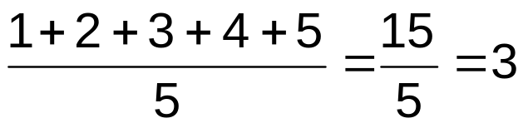
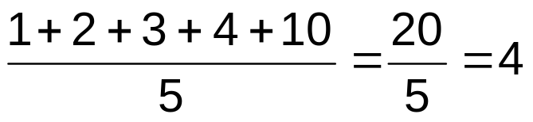
Measures of Central Tendency:
The Mean
(continued)
The most common measure of central tendency
Mean = sum of values divided by the number of values
Affected by extreme values (outliers)
0 1 2 3 4 5 6 7 8 9 10
0 1 2 3 4 5 6 7 8 9 10
Mean = 3
Mean = 4
Basic Business Statistics, 11e © 2009 Prentice-Hall, Inc..
Chap 3-<number>

Slide 6
Measures of Central Tendency:
The Median
In an ordered array, the median is the “middle” number (50% above, 50% below)
Not affected by extreme values
0 1 2 3 4 5 6 7 8 9 10
0 1 2 3 4 5 6 7 8 9 10
Median = 3
Median = 3
Basic Business Statistics, 11e © 2009 Prentice-Hall, Inc..
Chap 3-<number>

Slide 7
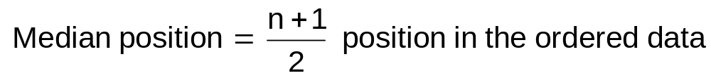
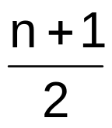
Measures of Central Tendency:
Locating the Median
The location of the median when the values are in numerical order (smallest to largest):
If the number of values is odd, the median is the middle number
If the number of values is even, the median is the average of the two middle numbers
Note that is not the value of the median, only the position of
the median in the ranked data
Basic Business Statistics, 11e © 2009 Prentice-Hall, Inc..
Chap 3-<number>

Slide 8
Measures of Central Tendency:
The Mode
Value that occurs most often
Not affected by extreme values
Used for either numerical or categorical (nominal) data
There may may be no mode
There may be several modes
0 1 2 3 4 5 6 7 8 9 10 11 12 13 14
0 1 2 3 4 5 6
No Mode
Mode = 9
Basic Business Statistics, 11e © 2009 Prentice-Hall, Inc..
Chap 3-<number>

Slide 9
Measures of Central Tendency:
Review Example
House Prices:
$2,000,000
$500,000
$300,000
$100,000
$100,000
Sum $3,000,000
Mean: ($3,000,000/5)
= $600,000
Median: middle value of ranked data
= $300,000
Mode: most frequent value
= $100,000
Basic Business Statistics, 11e © 2009 Prentice-Hall, Inc..
Chap 3-<number>

Slide 10
Measures of Central Tendency:
Which Measure to Choose?
The mean is generally used, unless extreme values (outliers) exist.
The median is often used, since the median is not sensitive to extreme values. For example, median home prices may be reported for a region; it is less sensitive to outliers.
In some situations it makes sense to report both the mean and the median.
Basic Business Statistics, 11e © 2009 Prentice-Hall, Inc..
Chap 3-<number>

Slide 11
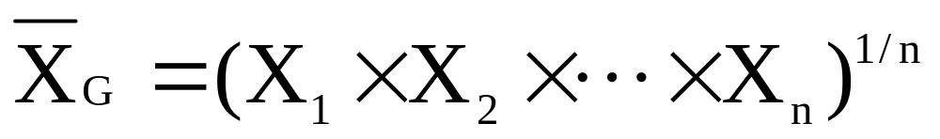
Measure of Central Tendency For The Rate Of Change Of A Variable Over Time:
The Geometric Mean & The Geometric Rate of Return
Geometric mean
  Used to measure the rate of change of a variable over time
Geometric mean rate of return
  Measures the status of an investment over time
  Where R_{i} is the rate of return in time period i
Basic Business Statistics, 11e © 2009 Prentice-Hall, Inc..
Chap 3-<number>

Slide 12
The Geometric Mean Rate of Return: Example
An investment of $100,000 declined to $50,000 at the end of year one and rebounded to $100,000 at end of year two:
50% decrease 100% increase
The overall two-year return is zero, since it started and ended at the same level.
Basic Business Statistics, 11e © 2009 Prentice-Hall, Inc..
Chap 3-<number>

Slide 13
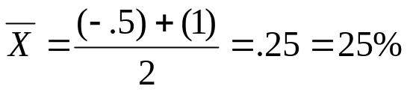
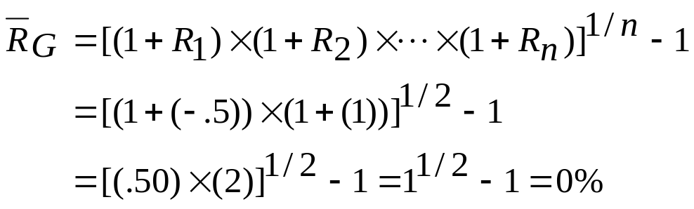
The Geometric Mean Rate of Return: Example
(continued)
Use the 1-year returns to compute the arithmetic mean and the geometric mean:
Arithmetic mean rate of return:
Misleading result
Geometric mean rate of return:
More
representative
result
Basic Business Statistics, 11e © 2009 Prentice-Hall, Inc..
Chap 3-<number>

Slide 14
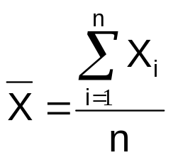

Measures of Central Tendency:
Summary
Central Tendency
Arithmetic Mean
Median
Mode
Geometric Mean
Middle value in the ordered array
Most frequently observed value
Rate of change of
a variable over time
Basic Business Statistics, 11e © 2009 Prentice-Hall, Inc..
Chap 3-<number>

Slide 15
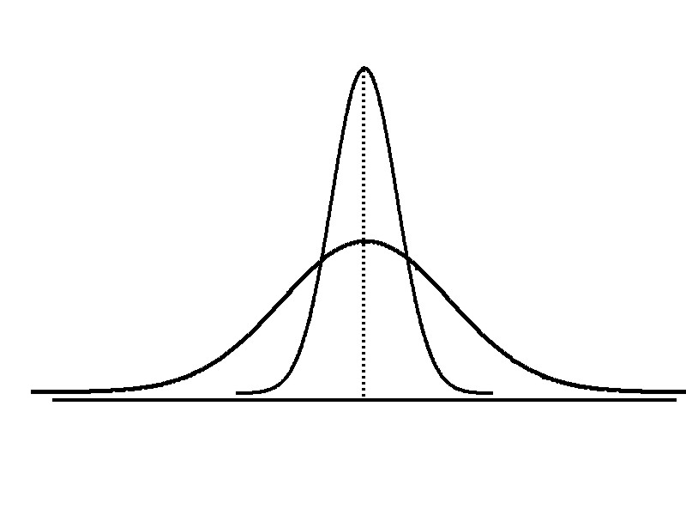
Measures of Variation
Variation
Range
Variance
Standard Deviation
Coefficient of Variation
Measures of variation give information on the spread or variability or dispersion of the data values.
Same center,
different variation
Basic Business Statistics, 11e © 2009 Prentice-Hall, Inc..
Chap 3-<number>

Slide 16
Measures of Variation:
The Range
Simplest measure of variation
Difference between the largest and the smallest values:
Range = X_{largest} – X_{smallest}
Example:
0 1 2 3 4 5 6 7 8 9 10 11 12 13 14
Range = 13 - 1 = 12
Basic Business Statistics, 11e © 2009 Prentice-Hall, Inc..
Chap 3-<number>

Slide 17
Measures of Variation:
Why The Range Can Be Misleading
Ignores the way in which data are distributed
Sensitive to outliers
7 8 9 10 11 12
7 8 9 10 11 12
Range = 12 - 7 = 5
Range = 12 - 7 = 5
1,1,1,1,1,1,1,1,1,1,1,2,2,2,2,2,2,2,2,3,3,3,3,4,5
Range = 5 - 1 = 4
1,1,1,1,1,1,1,1,1,1,1,2,2,2,2,2,2,2,2,3,3,3,3,4,120
Range = 120 - 1 = 119
Basic Business Statistics, 11e © 2009 Prentice-Hall, Inc..
Chap 3-<number>

Slide 18
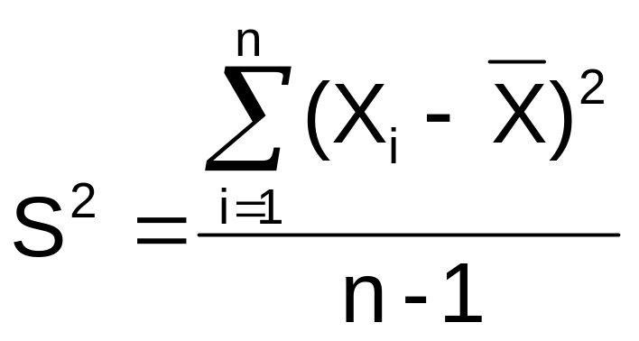

Measures of Variation:
The Variance
Average (approximately) of squared deviations of values from the mean
  Sample variance:
Where
= arithmetic mean
n = sample size
X_{i} = i^{th} value of the variable X
Basic Business Statistics, 11e © 2009 Prentice-Hall, Inc..
Chap 3-<number>

Slide 19
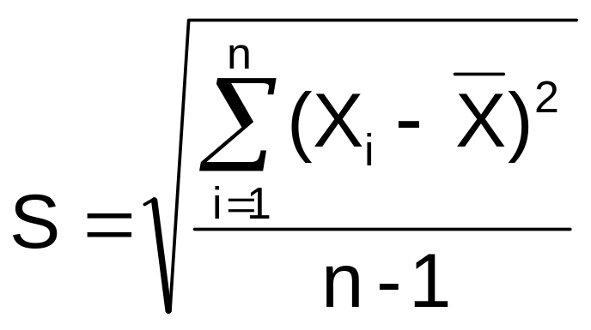
Measures of Variation:
The Standard Deviation
Most commonly used measure of variation
Shows variation about the mean
Is the square root of the variance
Has the same units as the original data
  Sample standard deviation:
Basic Business Statistics, 11e © 2009 Prentice-Hall, Inc..
Chap 3-<number>

Slide 20
Measures of Variation:
The Standard Deviation
Steps for Computing Standard Deviation
1. Compute the difference between each value and the mean.
2. Square each difference.
3. Add the squared differences.
4. Divide this total by n-1 to get the sample variance.
5. Take the square root of the sample variance to get the sample standard deviation.
Basic Business Statistics, 11e © 2009 Prentice-Hall, Inc..
Chap 3-<number>

Slide 21
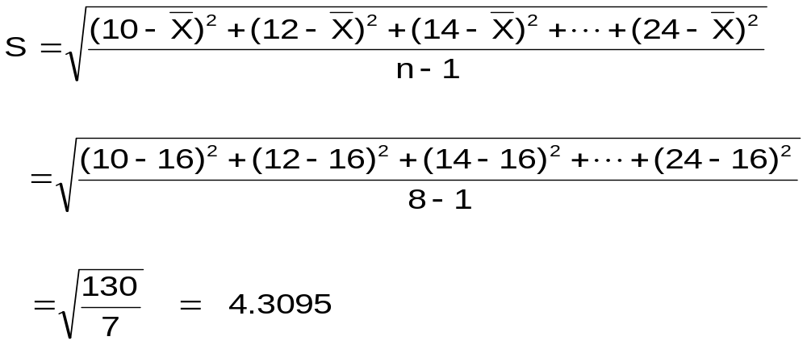
Measures of Variation:
Sample Standard Deviation:
Calculation Example
Sample
Data (X_{i}) : 10 12 14 15 17 18 18 24
n = 8 Mean = X = 16
A measure of the “average” scatter around the mean
Basic Business Statistics, 11e © 2009 Prentice-Hall, Inc..
Chap 3-<number>

Slide 22
Measures of Variation:
Comparing Standard Deviations
Data A
Mean = 15.5
S = 3.338
11 12 13 14 15 16 17 18 19 20 21
Data B
Mean = 15.5
S = 0.926
11 12 13 14 15 16 17 18 19 20 21
Data C
Mean = 15.5
S = 4.570
11 12 13 14 15 16 17 18 19 20 21
Basic Business Statistics, 11e © 2009 Prentice-Hall, Inc..
Chap 3-<number>

Slide 23
Measures of Variation:
Comparing Standard Deviations
Smaller standard deviation
Larger standard deviation
Basic Business Statistics, 11e © 2009 Prentice-Hall, Inc..
Chap 3-<number>

Slide 24
Measures of Variation:
Summary Characteristics
The more the data are spread out, the greater the range, variance, and standard deviation.
The more the data are concentrated, the smaller the range, variance, and standard deviation.
If the values are all the same (no variation), all these measures will be zero.
None of these measures are ever negative.
Basic Business Statistics, 11e © 2009 Prentice-Hall, Inc..
Chap 3-<number>

Slide 25
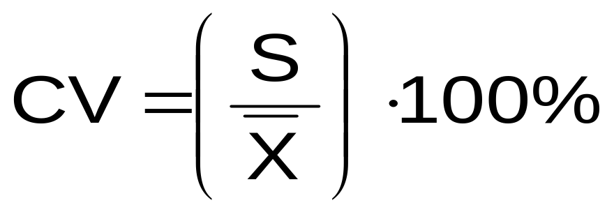
Measures of Variation:
The Coefficient of Variation
Measures relative variation
Always in percentage (%)
Shows variation relative to mean
Can be used to compare the variability of two or more sets of data measured in different units
Basic Business Statistics, 11e © 2009 Prentice-Hall, Inc..
Chap 3-<number>

Slide 26
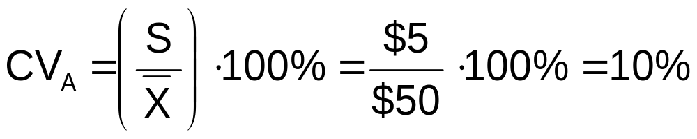
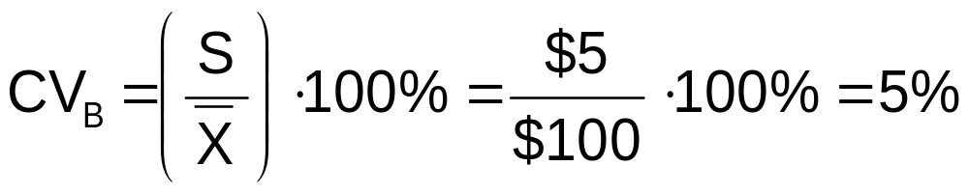
Measures of Variation:
Comparing Coefficients of Variation
Stock A:
  Average price last year = $50
  Standard deviation = $5
Stock B:
  Average price last year = $100
  Standard deviation = $5
Both stocks have the same standard deviation, but stock B is less variable relative to its price
Basic Business Statistics, 11e © 2009 Prentice-Hall, Inc..
Chap 3-<number>

Slide 27
Locating Extreme Outliers:
Z-Score
To compute the Z-score of a data value, subtract the mean and divide by the standard deviation.
The Z-score is the number of standard deviations a data value is from the mean.
A data value is considered an extreme outlier if its Z-score is less than -3.0 or greater than +3.0.
The larger the absolute value of the Z-score, the farther the data value is from the mean.
Basic Business Statistics, 11e © 2009 Prentice-Hall, Inc..
Chap 3-<number>

Slide 28
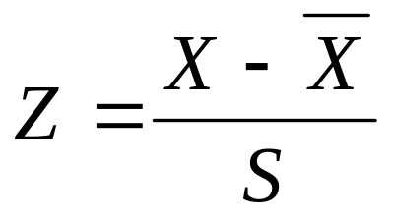
Locating Extreme Outliers:
Z-Score
where X represents the data value
X is the sample mean
S is the sample standard deviation
Basic Business Statistics, 11e © 2009 Prentice-Hall, Inc..
Chap 3-<number>

Slide 29
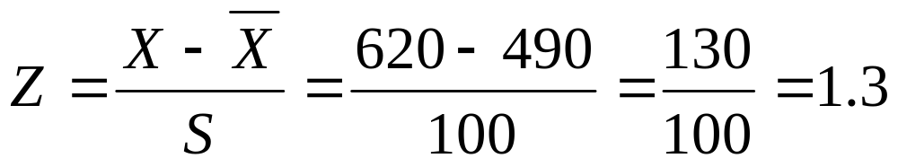
Locating Extreme Outliers:
Z-Score
Suppose the mean math SAT score is 490, with a standard deviation of 100.
Compute the Z-score for a test score of 620.
A score of 620 is 1.3 standard deviations above the mean and would not be considered an outlier.
Basic Business Statistics, 11e © 2009 Prentice-Hall, Inc..
Chap 3-<number>

Slide 30
Shape of a Distribution
Describes how data are distributed
Measures of shape
  Symmetric or skewed
Left-Skewed
Symmetric
Right-Skewed
Mean < Median
Mean = Median
Median < Mean
Basic Business Statistics, 11e © 2009 Prentice-Hall, Inc..
Chap 3-<number>

Slide 31
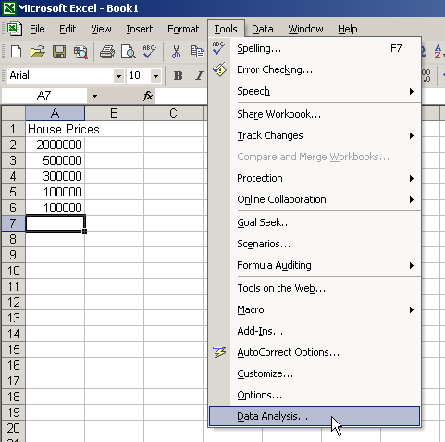
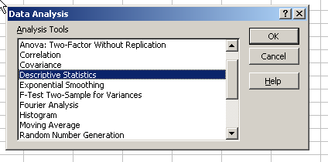
General Descriptive Stats Using Microsoft Excel
Select Tools.
Select Data Analysis.
Select Descriptive Statistics and click OK.
Basic Business Statistics, 11e © 2009 Prentice-Hall, Inc..
Chap 3-<number>

Slide 32
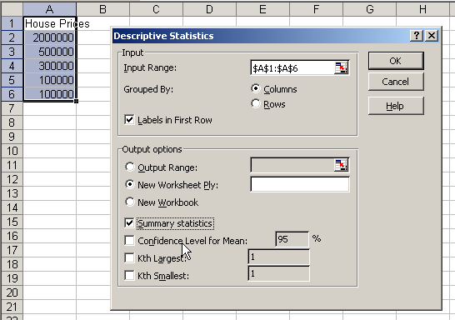
General Descriptive Stats Using Microsoft Excel
4. Enter the cell range.
5. Check the Summary Statistics box.
6. Click OK
Basic Business Statistics, 11e © 2009 Prentice-Hall, Inc..
Chap 3-<number>

Slide 33
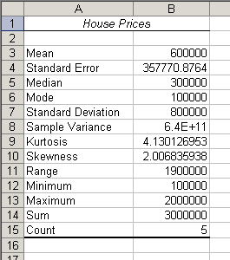
Excel output
Microsoft Excel
descriptive statistics output,
using the house price data:
House Prices:
$2,000,000
500,000
300,000
100,000
100,000

Slide 34
Minitab Output
Descriptive Statistics: House Price
Total
Variable Count Mean SE Mean StDev Variance Sum Minimum
House Price 5 600000 357771 800000 6.40000E+11 3000000 100000
N for
Variable Median Maximum Range Mode Skewness Kurtosis
House Price 300000 2000000 1900000 100000 2.01 4.13
Basic Business Statistics, 11e © 2009 Prentice-Hall, Inc..
Chap 3-<number>

Slide 35
Numerical Descriptive Measures for a Population
Descriptive statistics discussed previously described a sample, not the population.
Summary measures describing a population, called parameters, are denoted with Greek letters.
Important population parameters are the population mean, variance, and standard deviation.
Basic Business Statistics, 11e © 2009 Prentice-Hall, Inc..
Chap 3-<number>

Slide 36
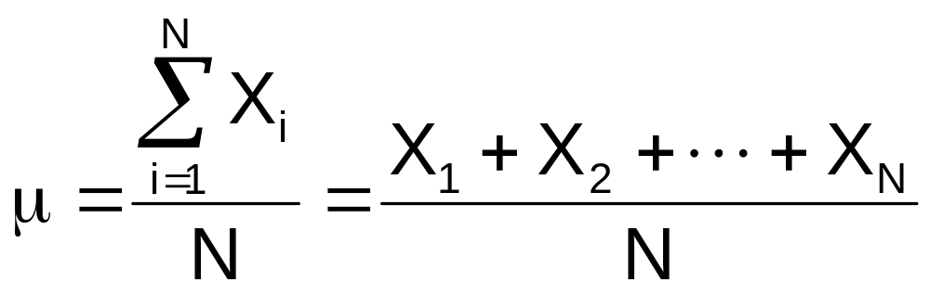
Numerical Descriptive Measures for a Population: The mean µ
The population mean is the sum of the values in the population divided by the population size, N
Where
μ = population mean
N = population size
X_{i} = i^{th} value of the variable X
Basic Business Statistics, 11e © 2009 Prentice-Hall, Inc..
Chap 3-<number>

Slide 37
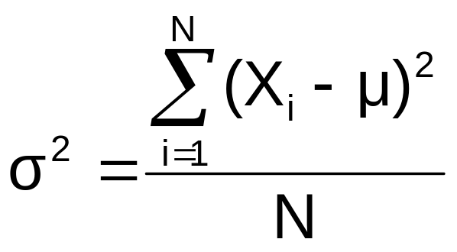
Numerical Descriptive Measures For A Population: The Variance σ²
Average of squared deviations of values from the mean
  Population variance:
Where
μ = population mean
N = population size
X_{i} = i^{th} value of the variable X
Basic Business Statistics, 11e © 2009 Prentice-Hall, Inc..
Chap 3-<number>

Slide 38
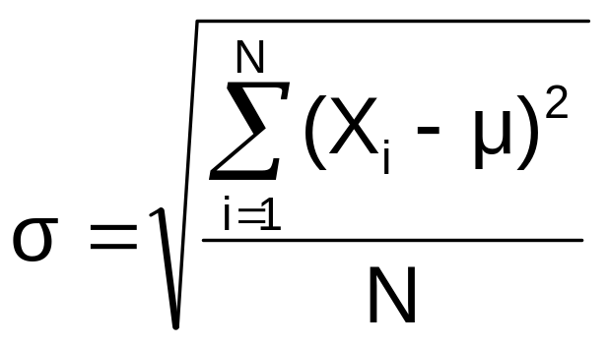
Numerical Descriptive Measures For A Population: The Standard Deviation σ
Most commonly used measure of variation
Shows variation about the mean
Is the square root of the population variance
Has the same units as the original data
  Population standard deviation:
Basic Business Statistics, 11e © 2009 Prentice-Hall, Inc..
Chap 3-<number>

Slide 39
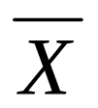





Sample statistics versus population parameters
Measure | Population Parameter | Sample Statistic
Mean
Variance
Standard Deviation
Basic Business Statistics, 11e © 2009 Prentice-Hall, Inc..
Chap 3-<number>

Slide 40
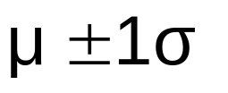


The Empirical Rule
The empirical rule approximates the variation of data in a bell-shaped distribution
Approximately 68% of the data in a bell shaped distribution is within 1 standard deviation of the mean or
68%
Basic Business Statistics, 11e © 2009 Prentice-Hall, Inc..
Chap 3-<number>

Slide 41


The Empirical Rule
Approximately 95% of the data in a bell-shaped distribution lies within two standard deviations of the mean, or µ ± 2σ
Approximately 99.7% of the data in a bell-shaped distribution lies within three standard deviations of the mean, or µ ± 3σ
95%
99.7%
Basic Business Statistics, 11e © 2009 Prentice-Hall, Inc..
Chap 3-<number>

Slide 42
Using the Empirical Rule
Suppose that the variable Math SAT scores is bell-shaped with a mean of 500 and a standard deviation of 90. Then,
  68% of all test takers scored between 410 and 590 (500 ± 90).
  95% of all test takers scored between 320 and 680 (500 ± 180).
  99.7% of all test takers scored between 230 and 770 (500 ± 270).
Basic Business Statistics, 11e © 2009 Prentice-Hall, Inc..
Chap 3-<number>

Slide 43
Chebyshev Rule
Regardless of how the data are distributed, at least (1 - 1/k²) x 100% of the values will fall within k standard deviations of the mean (for k > 1)
  Examples:
(1 - 1/2²) x 100% = 75% …........ k=2 (μ ± 2σ)
(1 - 1/3²) x 100% = 89% ………. k=3 (μ ± 3σ)
At least
within
Basic Business Statistics, 11e © 2009 Prentice-Hall, Inc..
Chap 3-<number>

Slide 44
Computing Numerical Descriptive Measures From A Frequency Distribution
Sometimes you have only a frequency distribution, not the raw data.
In this situation you can compute approximations to the mean and the standard deviation of the data
Basic Business Statistics, 11e © 2009 Prentice-Hall, Inc..
Chap 3-<number>

Slide 45
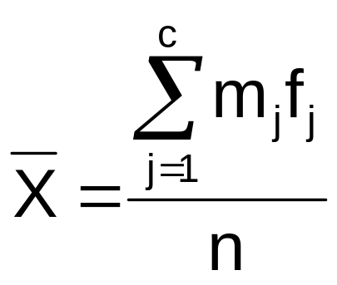
Approximating the Mean from a Frequency Distribution
Use the midpoint of a class interval to approximate the values in that class
  Where n = number of values or sample size
    c = number of classes in the frequency distribution
    m_{j} = midpoint of the j^{th} class
    f_{j} = number of values in the j^{th} class
Basic Business Statistics, 11e © 2009 Prentice-Hall, Inc..
Chap 3-<number>

Slide 46
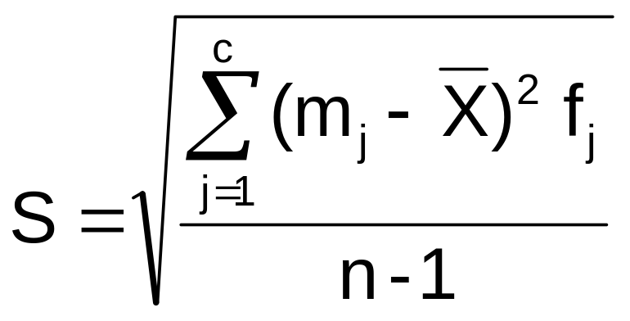
Approximating the Standard Deviation from a Frequency Distribution
Assume that all values within each class interval are located at the midpoint of the class
  Where n = number of values or sample size
    c = number of classes in the frequency distribution
    m_{j} = midpoint of the j^{th} class
    f_{j} = number of values in the j^{th} class
Basic Business Statistics, 11e © 2009 Prentice-Hall, Inc..
Chap 3-<number>

Slide 47
Quartile Measures
Quartiles split the ranked data into 4 segments with an equal number of values per segment
25%
25%
25%
25%
Q1
Q2
Q3
The first quartile, Q₁, is the value for which 25% of the observations are smaller and 75% are larger
Q₂ is the same as the median (50% of the observations are smaller and 50% are larger)
Only 25% of the observations are greater than the third quartile
Basic Business Statistics, 11e © 2009 Prentice-Hall, Inc..
Chap 3-<number>

Slide 48
Quartile Measures:
Locating Quartiles
Find a quartile by determining the value in the appropriate position in the ranked data, where
First quartile position: Q₁ = (n+1)/4 ranked value
Second quartile position: Q₂ = (n+1)/2 ranked value
Third quartile position: Q₃ = 3(n+1)/4 ranked value
where n is the number of observed values
Basic Business Statistics, 11e © 2009 Prentice-Hall, Inc..
Chap 3-<number>

Slide 49
Quartile Measures:
Calculation Rules
When calculating the ranked position use the following rules
  If the result is a whole number then it is the ranked position to use
  If the result is a fractional half (e.g. 2.5, 7.5, 8.5, etc.) then average the two corresponding data values.
  If the result is not a whole number or a fractional half then round the result to the nearest integer to find the ranked position.
Basic Business Statistics, 11e © 2009 Prentice-Hall, Inc..
Chap 3-<number>

Slide 50
Quartile Measures:
Locating Quartiles
Sample Data in Ordered Array: 11 12 13 16 16 17 18 21 22
(n = 9)
Q₁ is in the (9+1)/4 = 2.5 position of the ranked data
so use the value half way between the 2nd and 3rd values,
so Q₁ = 12.5
Q₁ and Q₃ are measures of non-central location
Q₂ = median, is a measure of central tendency
Basic Business Statistics, 11e © 2009 Prentice-Hall, Inc..
Chap 3-<number>

Slide 51
Quartile Measures
Calculating The Quartiles: Example
Sample Data in Ordered Array: 11 12 13 16 16 17 18 21 22
(n = 9)
Q₁ is in the (9+1)/4 = 2.5 position of the ranked data,
so Q₁ = (12+13)/2 = 12.5
Q₂ is in the (9+1)/2 = 5th position of the ranked data,
so Q₂ = median = 16
Q₃ is in the 3(9+1)/4 = 7.5 position of the ranked data,
so Q₃ = (18+21)/2 = 19.5
Q₁ and Q₃ are measures of non-central location
Q₂ = median, is a measure of central tendency
Basic Business Statistics, 11e © 2009 Prentice-Hall, Inc..
Chap 3-<number>

Slide 52
Quartile Measures:
The Interquartile Range (IQR)
The IQR is Q₃ – Q₁ and measures the spread in the middle 50% of the data
The IQR is also called the midspread because it covers the middle 50% of the data
The IQR is a measure of variability that is not influenced by outliers or extreme values
Measures like Q₁, Q₃, and IQR that are not influenced by outliers are called resistant measures
Basic Business Statistics, 11e © 2009 Prentice-Hall, Inc..
Chap 3-<number>

Slide 53
Calculating The Interquartile Range
Example:
Median
(Q₂)
X
X
Q₁
Q₃
minimum
maximum
25% 25% 25% 25%
12 30 45 57 70
Interquartile range
= 57 – 30 = 27
Basic Business Statistics, 11e © 2009 Prentice-Hall, Inc..
Chap 3-<number>

Slide 54
The Five Number Summary
The five numbers that help describe the center, spread and shape of data are:
  X_{smallest}
  First Quartile (Q₁)
  Median (Q₂)
  Third Quartile (Q₃)
  X_{largest}
Basic Business Statistics, 11e © 2009 Prentice-Hall, Inc..
Chap 3-<number>

Slide 55
Relationships among the five-number summary and distribution shape
Left-Skewed | Symmetric | Right-Skewed
Median – X_{smallest} > X_{largest} – Median | Median – X_{smallest} ≈ X_{largest} – Median | Median – X_{smallest} < X_{largest} – Median
Q₁ – X_{smallest} > X_{largest} – Q₃ | Q₁ – X_{smallest} ≈ X_{largest} – Q₃ | Q₁ – X_{smallest} < X_{largest} – Q₃
Median – Q₁ > Q₃ – Median | Median – Q₁ ≈ Q₃ – Median | Median – Q₁ < Q₃ – Median
Basic Business Statistics, 11e © 2009 Prentice-Hall, Inc..
Chap 3-<number>

Slide 56
Five Number Summary and
The Boxplot
The Boxplot: A Graphical display of the data based on the five-number summary:
X_{smallest} -- Q₁ -- Median -- Q₃ -- X_{largest}
Example:
25% of data 25% 25% 25% of data
of data of data
X_{smallest} Q₁ Median Q₃ X_{largest}
Basic Business Statistics, 11e © 2009 Prentice-Hall, Inc..
Chap 3-<number>

Slide 57
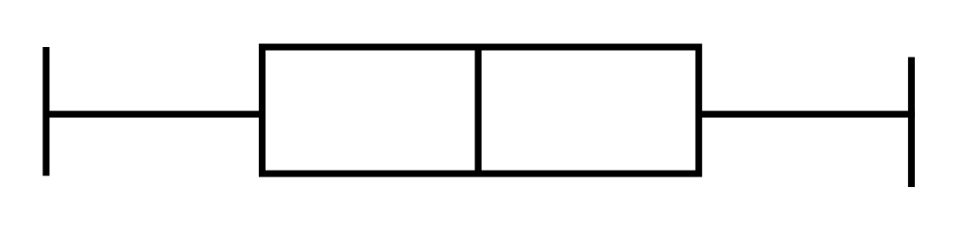
Five Number Summary:
Shape of Boxplots
If data are symmetric around the median then the box and central line are centered between the endpoints
A Boxplot can be shown in either a vertical or horizontal orientation
X_{smallest} Q₁ Median Q₃ X_{largest}
Basic Business Statistics, 11e © 2009 Prentice-Hall, Inc..
Chap 3-<number>

Slide 58
Distribution Shape and
The Boxplot
Left-Skewed
Symmetric
Right-Skewed
Q₁
Q₂
Q₃
Q₁
Q₂
Q₃
Q₁
Q₂
Q₃
Basic Business Statistics, 11e © 2009 Prentice-Hall, Inc..
Chap 3-<number>

Slide 59
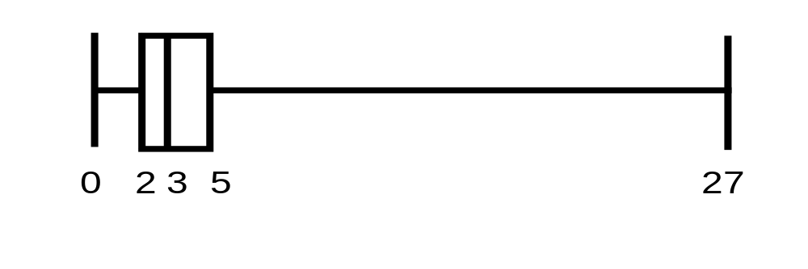
Boxplot Example
Below is a Boxplot for the following data:
0 2 2 2 3 3 4 5 5 9 27
The data are right skewed, as the plot depicts
X_{smallest} Q₁ Q₂ Q₃ X_{largest}
0 2 3 5 27
Basic Business Statistics, 11e © 2009 Prentice-Hall, Inc..
Chap 3-<number>

Slide 60
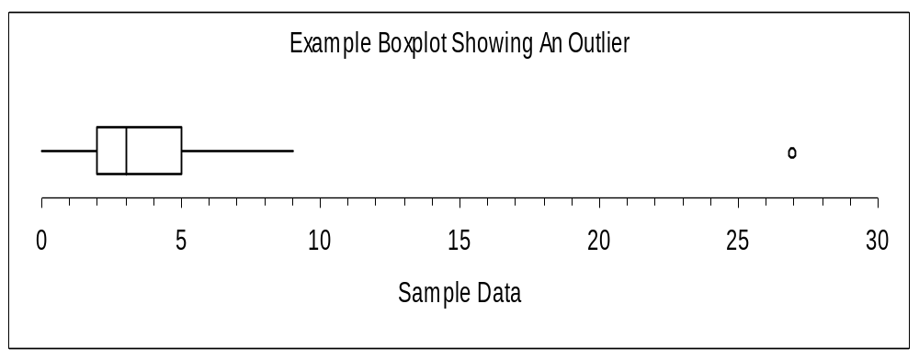
Boxplot example showing an outlier
The boxplot below of the same data shows the outlier value of 27 plotted separately
A value is considered an outlier if it is more than 1.5 times the interquartile range below Q₁ or above Q₃
Basic Business Statistics, 11e © 2009 Prentice-Hall, Inc..
Chap 3-<number>

Slide 61
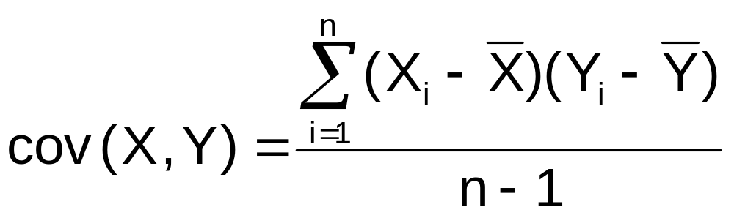
The Covariance
The covariance measures the strength of the linear relationship between two numerical variables (X & Y)
The sample covariance:
Only concerned with the strength of the relationship
No causal effect is implied
Basic Business Statistics, 11e © 2009 Prentice-Hall, Inc..
Chap 3-<number>

Slide 62
Interpreting Covariance
Covariance between two variables:
cov(X,Y) > 0 X and Y tend to move in the same direction
cov(X,Y) < 0 X and Y tend to move in opposite directions
cov(X,Y) = 0 X and Y are independent
The covariance has a major flaw:
  It is not possible to determine the relative strength of the relationship from the size of the covariance
Basic Business Statistics, 11e © 2009 Prentice-Hall, Inc..
Chap 3-<number>

Slide 63
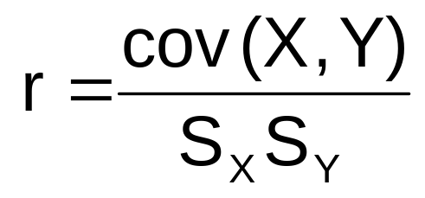
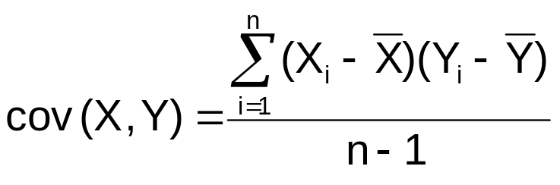
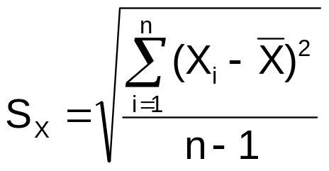

Coefficient of Correlation
Measures the relative strength of the linear relationship between two numerical variables
Sample coefficient of correlation:
where
Basic Business Statistics, 11e © 2009 Prentice-Hall, Inc..
Chap 3-<number>

Slide 64
Features of the
Coefficient of Correlation
The population coefficient of correlation is referred as ρ.
The sample coefficient of correlation is referred to as r.
Either ρ or r have the following features:
  Unit free
  Ranges between –1 and 1
  The closer to –1, the stronger the negative linear relationship
  The closer to 1, the stronger the positive linear relationship
  The closer to 0, the weaker the linear relationship
Basic Business Statistics, 11e © 2009 Prentice-Hall, Inc..
Chap 3-<number>

Slide 65
Scatter Plots of Sample Data with Various Coefficients of Correlation
Y
Y
X
X
r = -1
r = -.6
Y
Y
Y
X
X
X
r = +1
r = +.3
r = 0
Basic Business Statistics, 11e © 2009 Prentice-Hall, Inc..
Chap 3-<number>

Slide 66
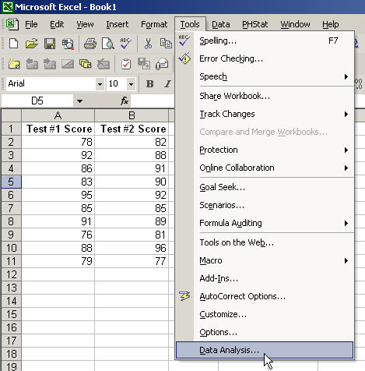
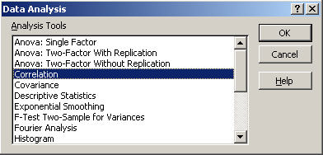
The Coefficient of Correlation
Using Microsoft Excel
Select Tools/Data Analysis
Choose Correlation from the selection menu
Click OK . . .
Basic Business Statistics, 11e © 2009 Prentice-Hall, Inc..
Chap 3-<number>

Slide 67
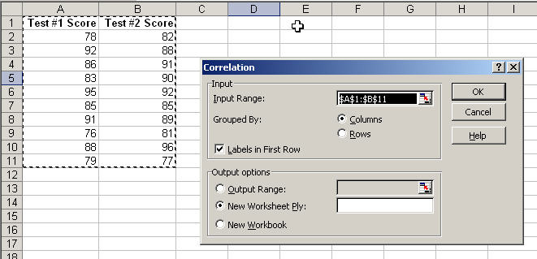

The Coefficient of Correlation
Using Microsoft Excel
Input data range and select appropriate options
Click OK to get output
Basic Business Statistics, 11e © 2009 Prentice-Hall, Inc..
Chap 3-<number>

Slide 68
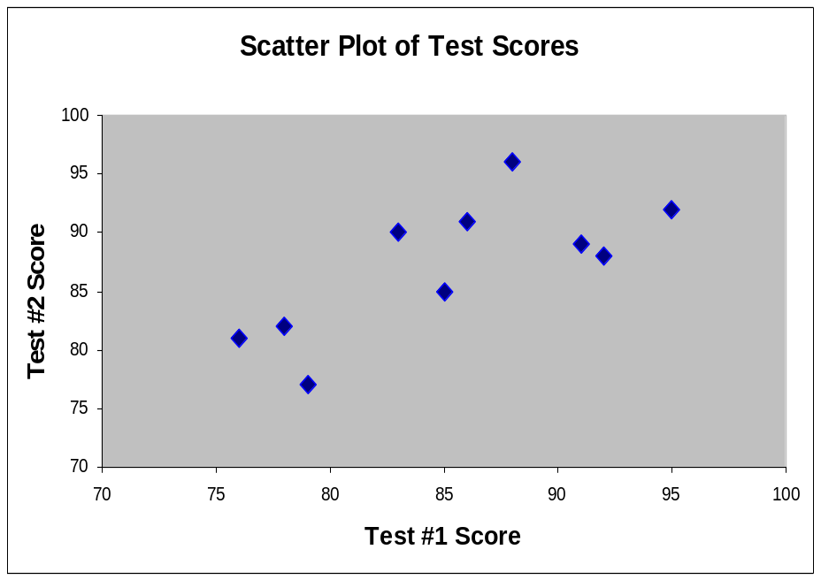
Interpreting the Coefficient of Correlation
Using Microsoft Excel
r = .733
There is a relatively strong positive linear relationship between test score #1 and test score #2.
Students who scored high on the first test tended to score high on second test.
Basic Business Statistics, 11e © 2009 Prentice-Hall, Inc..
Chap 3-<number>

Slide 69
Pitfalls in Numerical
Descriptive Measures
Data analysis is objective
  Should report the summary measures that best describe and communicate the important aspects of the data set
Data interpretation is subjective
  Should be done in fair, neutral and clear manner
Basic Business Statistics, 11e © 2009 Prentice-Hall, Inc..
Chap 3-<number>

Slide 70

Ethical Considerations
Numerical descriptive measures:
Should document both good and bad results
Should be presented in a fair, objective and neutral manner
Should not use inappropriate summary measures to distort facts
Basic Business Statistics, 11e © 2009 Prentice-Hall, Inc..
Chap 3-<number>

Slide 71
Chapter Summary
Described measures of central tendency
  Mean, median, mode, geometric mean
Described measures of variation
  Range, interquartile range, variance and standard deviation, coefficient of variation, Z-scores
Illustrated shape of distribution
  Symmetric, skewed
Described data using the 5-number summary
  Boxplots
Basic Business Statistics, 11e © 2009 Prentice-Hall, Inc..
Chap 3-<number>

Slide 72
Chapter Summary
(continued)
Discussed covariance and correlation coefficient
Addressed pitfalls in numerical descriptive measures and ethical considerations
Basic Business Statistics, 11e © 2009 Prentice-Hall, Inc..
Chap 3-<number>

